Slide 1
Logistics Optimization for Delivery Routes – Amazon
SQL PROJECT
PPT Presentation Video

Slide 2
Challenges
Faced by Logistics Team
1
Identifying delays and their root causes
2
Optimizing delivery routes for faster fulfillment.
3
Improving shipment efficiency through data-driven insights.

Slide 3
Project Objective
Build a SQL-driven Logistics analytics system to analyze delays, optimize routes, and enhance shipment efficiency by leveraging queries, aggregations. The project aims to answer key business questions, uncover inefficiencies, and recommend actionable improvements based on data analysis.

Slide 4
Dataset
1
Orders Table
2
Routes Table
3
Warehouse Table
4
Delivery Agent Table
5
Shipment Tracking Table

Slide 5
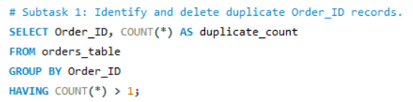
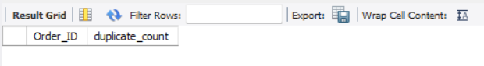
Task 1: Data Cleaning & Preparation
Subtask 1: Identify and delete duplicate Order_ID records.
SQL Query :
Insight / How Performed:
I used GROUP BY and HAVING COUNT(*) > 1 to detect duplicate Order_ID values.
Verified that no duplicates existed in the dataset.
Output :
Result:
0 rows returned - No duplicate Order_IDs found.
Data integrity confirmed - every order is unique.

Slide 6
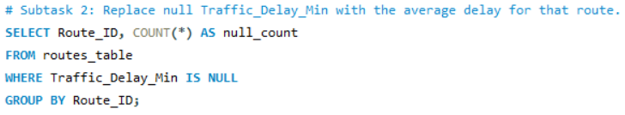
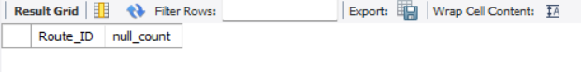
Task 1: Data Cleaning & Preparation
Subtask 2: Replace null Traffic_Delay_Min with the average delay for that route.
SQL Query :
Insight / How Performed:
Queried routes_table for NULL values in Traffic_Delay_Min.
Found no NULL records.
Output :
Result:
0 rows returned - No missing delay data.
All route delays are recorded, ensuring accurate travel time calculations.

Slide 7
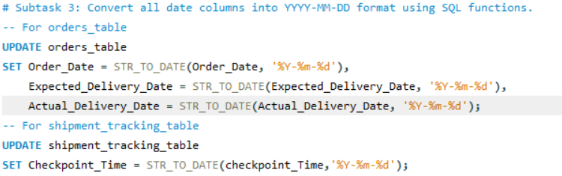
Task 1: Data Cleaning & Preparation
Subtask 3: Convert all date columns into YYYY-MM-DD format using SQL functions.
SQL Query :
Insight / How Performed:
Used STR_TO_DATE() to standardize date formats across orders_table and shipment_tracking_table.
Converted all date columns to the standard format: YYYY-MM-DD.
Output :
Result:
300 rows affected (Orders) and 1040 rows affected (Shipment Tracking).
Consistent date format allows proper delay and duration analysis using date functions.

Slide 8
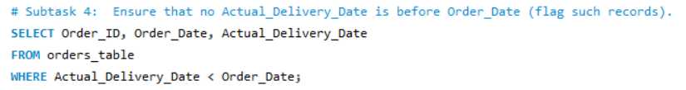
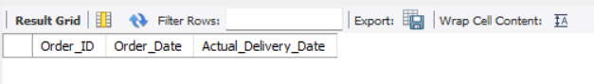
Task 1: Data Cleaning & Preparation
Subtask 4: Ensure that no Actual_Delivery_Date is before Order_Date (flag such records).
SQL Query :
Insight / How Performed:
Checked for logically invalid data where Actual_Delivery_Date < Order_Date.
Ensured that all deliveries occurred after orders were placed.
Output :
Result:
0 rows returned - No invalid records found.
Dataset verified for logical consistency.

Slide 9
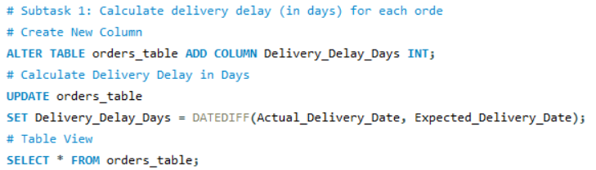
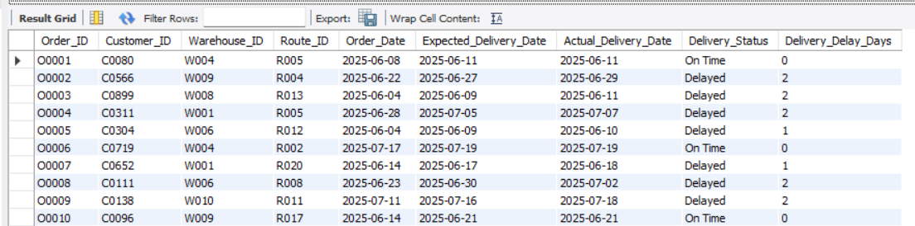
Task 2: Delivery Delay Analysis
Subtask 1: Calculate delivery delay (in days) for each order
SQL Query :
Insight / How Performed:
Added a new integer column Delivery_Delay_Days to orders_table to store day-level delays.
Populated the column using DATEDIFF(Actual_Delivery_Date, Expected_Delivery_Date) for all East orders.
Output :

Slide 10
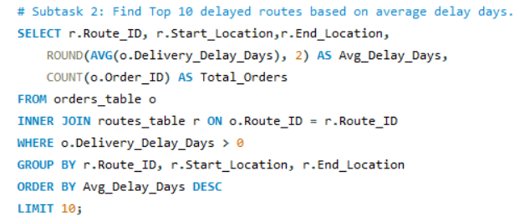
Task 2: Delivery Delay Analysis
Subtask 2: Find Top 10 delayed routes based on average delay days.
SQL Query :
Insight / How Performed:
Joined orders_table (o) with routes_table (r) using Route_ID.
Filtered records with Delivery_Delay_Days > 0 (delayed orders only).
Calculated average Delivery_Delay_Days and round it and order count per route.

Slide 11
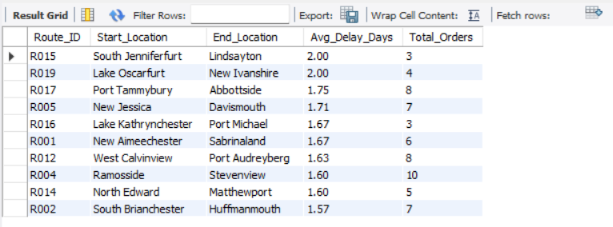
Task 2: Delivery Delay Analysis
Subtask 2: Find Top 10 delayed routes based on average delay days.
Output:
Result:
Returned a ranked list of the 10 most delayed routes with start and end locations, average delay, and total orders.
Example: Routes R015 and R019 showed 2 days average delay — indicating consistent lateness issues.
10 row(s) returned - Top delayed routes identified for further analysis.

Slide 12
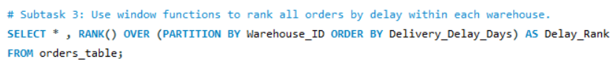
Task 2: Delivery Delay Analysis
Subtask 3: Use window functions to rank all orders by delay within each warehouse.
SQL Query :
Insight / How Performed:
I used a window function to rank orders by delay inside each warehouse.
This provides relative performance per warehouse (smaller delay = better rank).
Selected all columns to inspect rank distribution alongside delay and status.

Slide 13
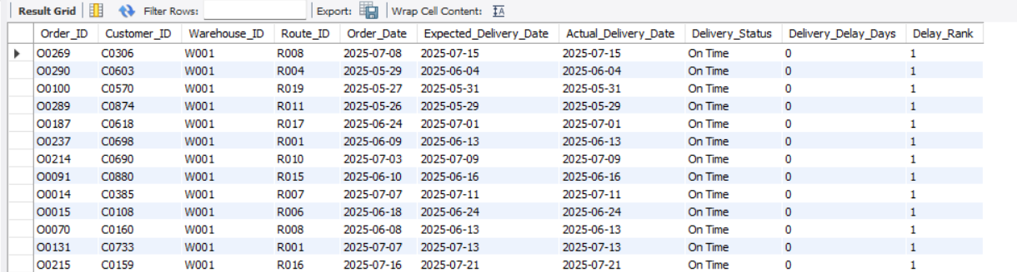
Task 2: Delivery Delay Analysis
Subtask 3: Use window functions to rank all orders by delay within each warehouse.
Output:
Result:
Generated Delay_Rank values for all orders.
Many on-time orders (0 delay days) ranked 1 within their warehouses.
Enables managers to compare warehouse efficiency easily.
300 row(s) returned - Ranks assigned for warehouse-level performance benchmarking.

Slide 14
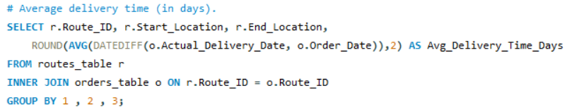
Task 3: Route Optimization Insights
Subtask 1: For each route, calculate: Average delivery time (in days).
SQL Query :
Insight / How Performed:
Joined routes_table (r) and orders_table (o) using Route_ID.
Calculated average delivery time per route using:
ROUND(AVG(DATEDIFF(o.Actual_Delivery_Date, o.Order_Date)), 2)
Grouped by Route_ID, Start_Location, and End_Location to ensure one metric per route direction.

Slide 15
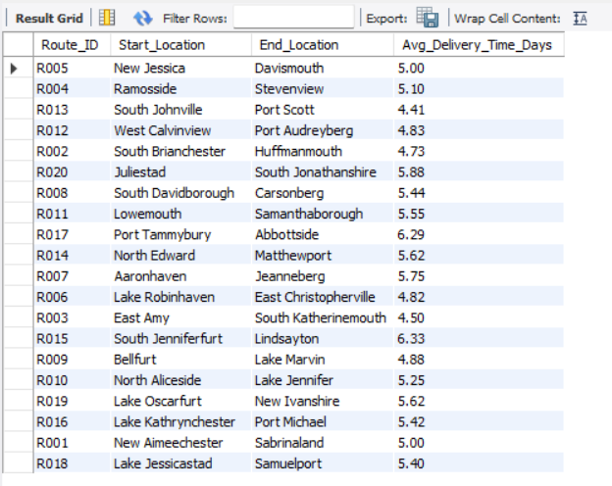
Task 3: Route Optimization Insights
Subtask 1: For each route, calculate: Average delivery time (in days).
Output:
Result:
Returned 20 routes with their average delivery time in days.
Example: Routes R005, R004, and R013 showed clearly distinct average delivery durations.
20 row(s) returned - Average delivery time computed for all routes.

Slide 16
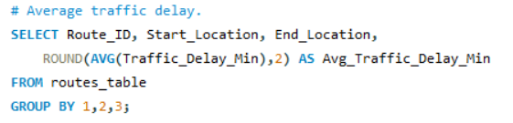
Task 3: Route Optimization Insights
Subtask 1: For each route, calculate: Average traffic delay.
SQL Query :
Insight / How Performed:
Aggregated average traffic delay directly from routes_table using:
ROUND(AVG(Traffic_Delay_Min), 2)
Grouped by Route_ID, Start_Location, End_Location to retain local interpretability.

Slide 17
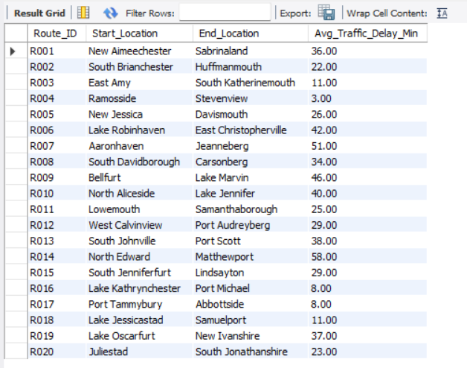
Task 3: Route Optimization Insights
Subtask 1: For each route, calculate: Average traffic delay.
Output:
Result:
Returned 20 rows with average traffic delay per route.
Values ranged from - 3 to 58 minutes, showing clear variation in congestion patterns.
20 row(s) returned -Average traffic delay computed successfully.

Slide 18
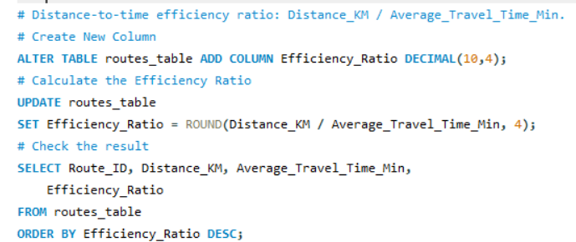
Task 3: Route Optimization Insights
Subtask 1: For each route, calculate: Distance-to-time efficiency ratio: Distance_KM / Average_Travel_Time_Min.
SQL Query :
Insight / How Performed:
Added column as Efficiency_Ratio DECIMAL(10,4) to routes_table, then updated it as ROUND(Distance_KM / Average_Travel_Time_Min, 4).
Verified results with a SELECT query comparing distance, travel time, and efficiency ratio per route.

Slide 19
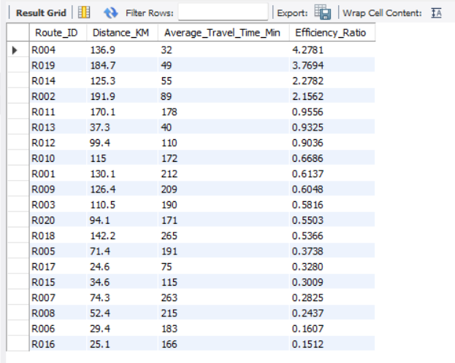
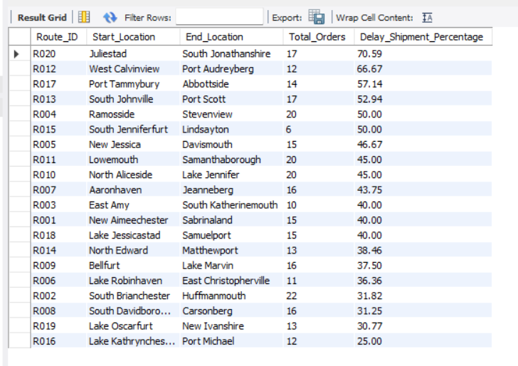
Task 3: Route Optimization Insights
Subtask 1: For each route, calculate: Distance-to-time efficiency ratio: Distance_KM / Average_Travel_Time_Min.
Output :
Result:
Column added successfully; 20 rows matched, 0 changed, indicating all ratios were up to date.
Output verified correct ratio values across all routes.
0 row(s) affected; 20 matched - Efficiency_Ratio validated for all routes.

Slide 20
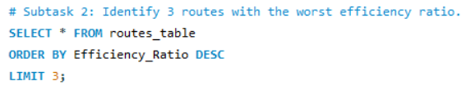
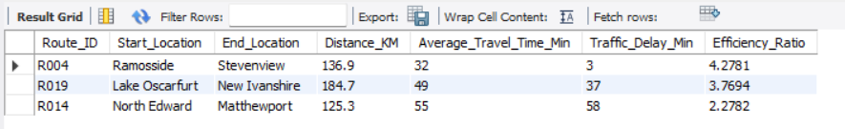
Task 3: Route Optimization Insights
Subtask 2: Identify 3 routes with the worst efficiency ratio.
SQL Query :
Insight / How Performed:
Ranked routes by Efficiency_Ratio in descending order to surface the least efficient distance‑to‑time performance and limited the result to 3.
Focused on highest ratios - longer travel time per kilometer (least efficient).
Output :
Result:
Identified R004, R019, and R014 as the lowest-performing routes.
These routes consume excess travel time relative to distance covered.
3 row(s) returned - Worst-efficiency routes isolated for optimization.

Slide 21
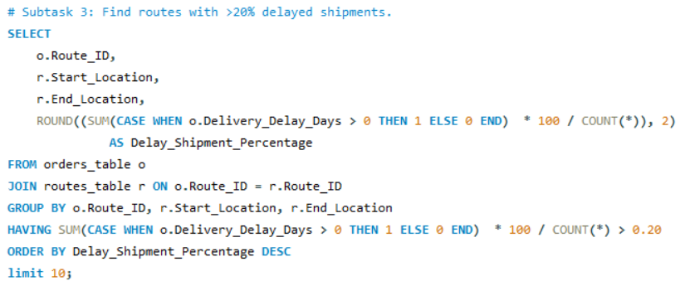
Task 3: Route Optimization Insights
Subtask 3: Find routes with >20% delayed shipments.
SQL Query :
Insight / How Performed:
Joined orders_table (o) and routes_table (r) on Route_ID.
Calculated delayed shipment percentage using: ROUND(SUM(CASE WHEN o.Delivery_Delay_Days > 0 THEN 1 ELSE 0 END) * 100 / COUNT(*), 2)
Grouped by route and filtered with HAVING Delay_Shipment_Percentage > 20.

Slide 22
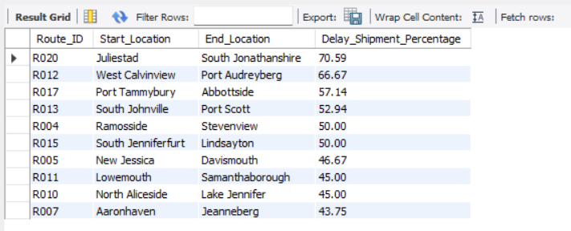
Task 3: Route Optimization Insights
Subtask 3: Find routes with >20% delayed shipments.
Output :
Result:
Highlighted high-risk routes: R020, R012, R017, R013 with 50–70% of shipments delayed.
These lanes require immediate operational review.
10 row(s) returned - Routes exceeding 20% delay identified.

Slide 23
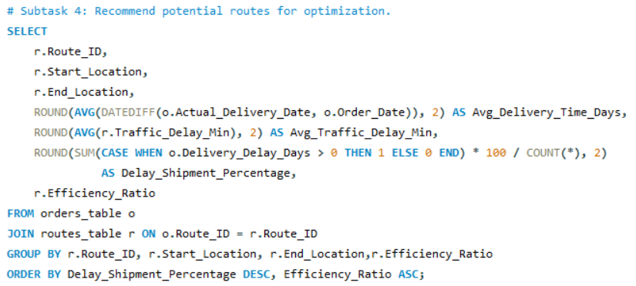
Task 3: Route Optimization Insights
Subtask 4: Recommend potential routes for optimization.
SQL Query :
Insight / How Performed:
Joined orders_table (o) and routes_table (r) on Route_ID.
Combined all key route metrics: Avg_Delivery_Time_Days, Avg_Traffic_Delay_Min, Delay_Shipment_Percentage, and Efficiency_Ratio.
Ordered by Delay_Shipment_Percentage DESC and Efficiency_Ratio ASC to identify top candidates for optimization.

Slide 24
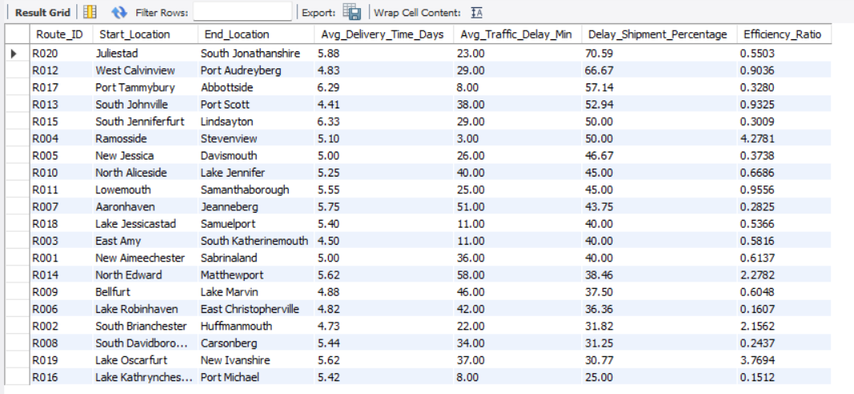
Task 3: Route Optimization Insights
Subtask 4: Recommend potential routes for optimization.
Output :
Result:
Generated a ranked list of routes combining delay rate and efficiency ratio.
Routes R020, R012, RO17, RO13 and RO15 surfaced as prime targets for re-routing or scheduling adjustments.
20 row(s) returned - optimization list generated - ready for managerial action.

Slide 25
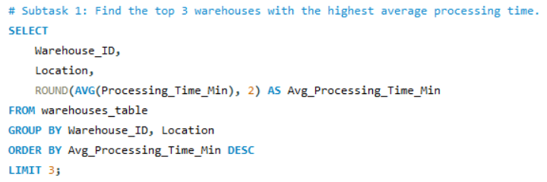
Task 4: Warehouse Performance
Subtask 1: Find the top 3 warehouses with the highest average processing time.
SQL Query :
Insight / How Performed:
Calculated per-warehouse averages using: ROUND(AVG(Processing_Time_Min), 2)
Sorted results in descending order to highlight the slowest processors.

Slide 26
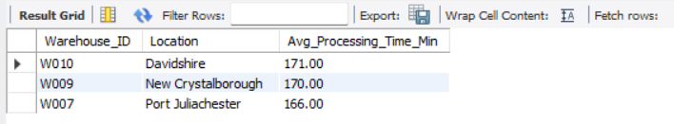
Task 4: Warehouse Performance
Subtask 1: Find the top 3 warehouses with the highest average processing time.
Output :
Result:
Returned 3 warehouses (W010, W009, W007) with the highest average processing time.
These represent immediate targets for process improvement and resource review.
3 row(s) returned - Slowest three warehouses identified for efficiency review.

Slide 27
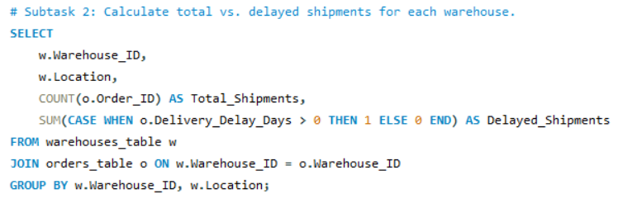
Task 4: Warehouse Performance
Subtask 2: Calculate total vs. delayed shipments for each warehouse.
SQL Query :
Insight / How Performed:
Joined warehouses_table (w) with orders_table (o) using Warehouse_ID.
Computed total and delayed shipments with: COUNT(o.Order_ID) AS Total_Shipments and SUM(CASE WHEN o.Delivery_Delay_Days > 0 THEN 1 ELSE 0 END)

Slide 28
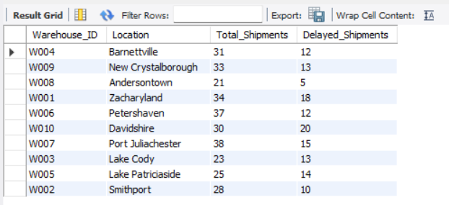
Task 4: Warehouse Performance
Subtask 2: Calculate total vs. delayed shipments for each warehouse.
Output :
Result:
Generated per-warehouse shipment counts and delay totals.
Examples: W004, W009, W008, and W001 show diverse delay volumes - critical for prioritizing fixes.
10 row(s) returned - Shipment volumes and delay counts computed for all warehouses.

Slide 29
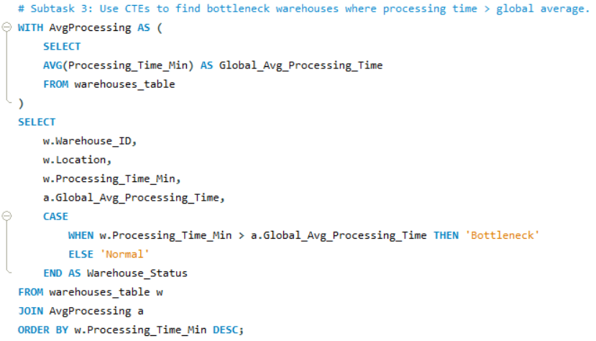
Task 4: Warehouse Performance
Subtask 3: Use CTEs to find bottleneck warehouses where processing time > global average.
SQL Query :
Insight / How Performed:
Built a CTE AvgProcessing computing Global_Avg_Processing_Time = AVG(Processing_Time_Min).
Joined to warehouses_table and classified Warehouse_Status with CASE WHEN w.Processing_Time_Min > a.Global_Avg_Processing_Time THEN 'Bottleneck' ELSE 'Normal'

Slide 30
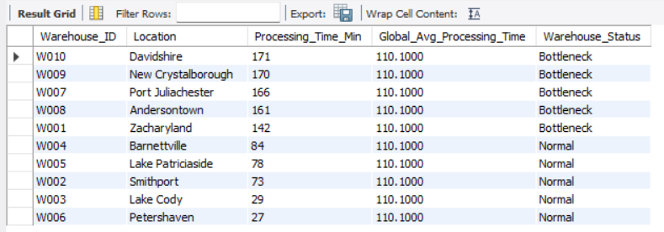
Task 4: Warehouse Performance
Subtask 3: Use CTEs to find bottleneck warehouses where processing time > global average.
Output :
Result:
Identified global average = 110.1000 minutes.
Flagged bottleneck warehouses: W010, W009, W007, W008, W001.
10 row(s) returned - Bottleneck classification completed against global benchmark.

Slide 31
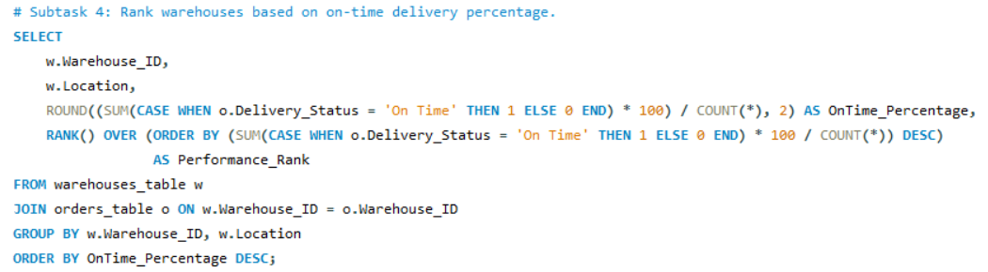
Task 4: Warehouse Performance
Subtask 4: Rank warehouses based on on-time delivery percentage.
SQL Query :
Insight / How Performed:
Computed OnTime_Percentage as ROUND((SUM(CASE WHEN o.Delivery_Status = 'On Time' THEN 1 ELSE 0 END) * 100) / COUNT(*), 2).
Assigned Performance_Rank using RANK() OVER (ORDER BY OnTime_Percentage DESC) to compare warehouses fairly.

Slide 32
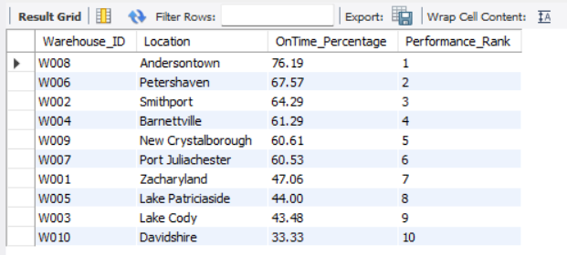
Task 4: Warehouse Performance
Subtask 4: Rank warehouses based on on-time delivery percentage.
Output :
Result:
Returned performance rankings for 10 warehouses.
Top performers: W008 and W006 with highest On-Time %, while W010 lags significantly.
Enables focused coaching and operational improvement for low rank warehouses.
10 row(s) returned - On-time performance ranking generated for all warehouses.

Slide 33
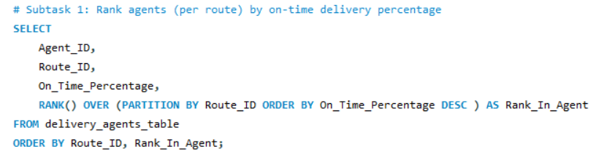
Task 5: Delivery Agent Performance
Subtask 1: Rank agents (per route) by on-time delivery percentage
SQL Query :
Insight / How Performed:
Selected Agent_ID, Route_ID, On_Time_Percentage and applied a window function RANK() OVER (PARTITION BY Route_ID ORDER BY On_Time_Percentage DESC) AS Rank_In_Agent.
Ordered the output by Route_ID then Rank_In_Agent to present a clear leaderboard within each route.

Slide 34
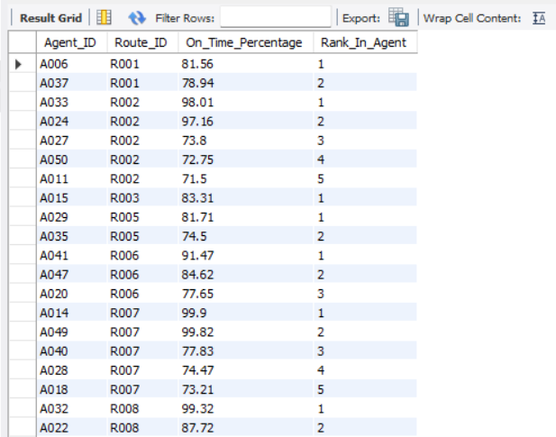
Task 5: Delivery Agent Performance
Subtask 1: Rank agents (per route) by on-time delivery percentage
Output :
Result:
Returned 50 rows, showing each agent’s rank within their route.
Higher On_Time_Percentage received better ranks (rank = 1), ties share the same rank.
Example: Agent A006 on R001 ranked 1 with 81.56% on-time performance.
50 row(s) returned - Agent rankings generated across all routes.

Slide 35
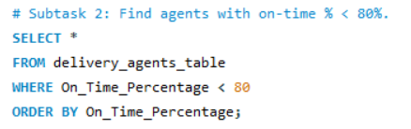
Task 5: Delivery Agent Performance
Subtask 2: Find agents with on-time % < 80%.
SQL Query :
Insight / How Performed:
Filtered underperforming agents using: WHERE On_Time_Percentage < 80
Focused on agents needing coaching, route reassignment, or schedule adjustments.

Slide 36
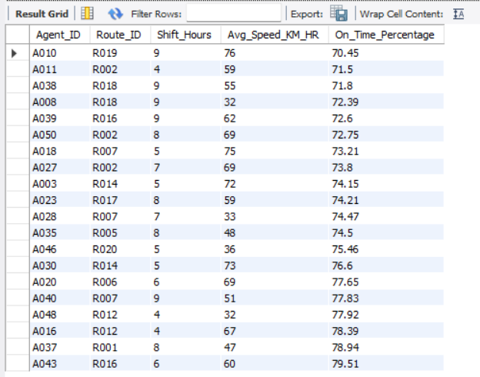
Task 5: Delivery Agent Performance
Subtask 2: Find agents with on-time % < 80%.
Output :
Result:
Returned 20 rows listing agents with on-time % below 80.
Output includes route, shift hours, average speed, and on-time percentage.
Highlights low-performing agents for targeted training.
20 row(s) returned - Under threshold agents identified for corrective action.

Slide 37
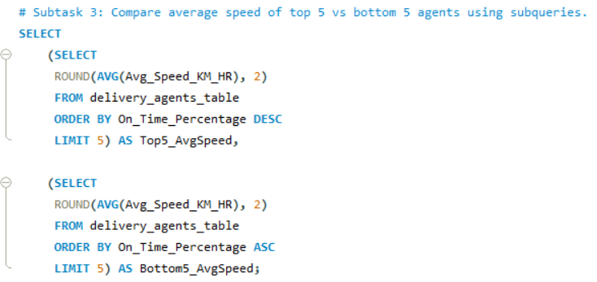
Task 5: Delivery Agent Performance
Subtask 3: Compare average speed of top 5 vs bottom 5 agents using subqueries
SQL Query :
Insight / How Performed:
I used scalar subqueries to compare speeds of top and bottom performers.
Provided both averages in a single row for easy visual comparison.

Slide 38
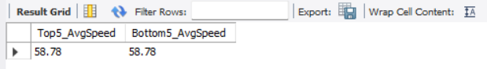
Task 5: Delivery Agent Performance
Subtask 3: Compare average speed of top 5 vs bottom 5 agents using subqueries
Output :
Result:
Returned 1 row with Top5_AvgSpeed and Bottom5_AvgSpeed.
Example output: both = 58.78 km/hr, showing similar speed profiles between groups.
Suggests that speed alone doesn’t determine on-time delivery other factors like route congestion or process adherence matter.
1 row(s) returned - Top-vs-bottom speed comparison computed successfully.

Slide 39
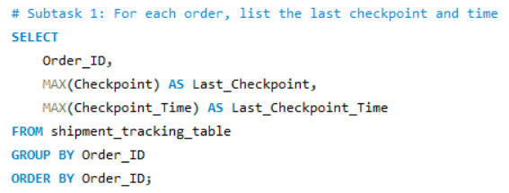
Task 6: Shipment Tracking Analytics
Subtask 1: For each order, list the last checkpoint and time.
SQL Query :
Insight / How Performed:
Queried shipment_tracking_table to find the most recent checkpoint per order.
Used MAX() to extract the latest checkpoint and time for each order, ensuring one record per shipment.
Sorted by Order_ID to provide a clean list for auditing and customer updates.

Slide 40
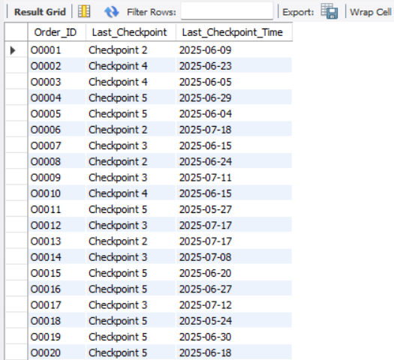
Task 6: Shipment Tracking Analytics
Subtask 1: For each order, list the last checkpoint and time.
Output :
Result:
Returned 300 rows, one per order.
Example: Orders O0002 show their last recorded checkpoint is 4 and timestamp is 2025-06-23.
Confirms full data coverage for all active shipments.
300 row(s) returned - Last checkpoint details retrieved for all orders.

Slide 41
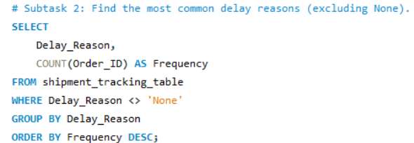
Task 6: Shipment Tracking Analytics
Subtask 2: Find the most common delay reasons (excluding None).
SQL Query :
Insight / How Performed:
Aggregated delay counts to find the most frequent delay reasons.
Excluded records with “None” to count only meaningful delays.

Slide 42
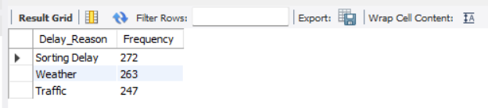
Task 6: Shipment Tracking Analytics
Subtask 2: Find the most common delay reasons (excluding None).
Output :
Result:
Returned 3 delay categories ranked by occurrence:
Sorting Delay - 272 occurrences
Weather - 263 occurrences
Traffic - 247 occurrences
Indicates sorting process inefficiencies as the top delay cause.
3 row(s) returned - Major delay reasons summarized successfully.

Slide 43
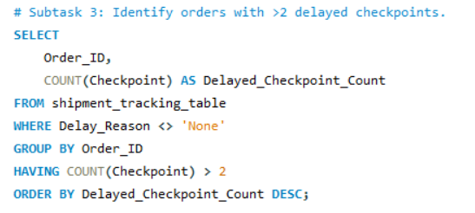
Task 6: Shipment Tracking Analytics
Subtask 3: Identify orders with >2 delayed checkpoints
SQL Query :
Insight / How Performed:
Counted checkpoints per order that had a non- ‘None’ delay reason.
Applied HAVING COUNT(Checkpoint) > 2 to flag orders repeatedly delayed for escalation.
Highlighted orders repeatedly facing tracking delays to target them for investigation.

Slide 44
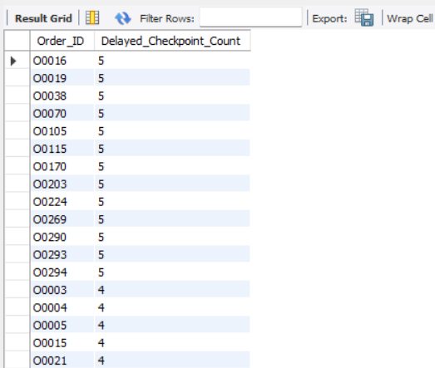
Task 6: Shipment Tracking Analytics
Subtask 3: Identify orders with >2 delayed checkpoints
Output :
Result:
Returned 151 rows (orders with >= 3 delayed checkpoints).
Example: Orders 00016, 00019, 00038, 00100 each had 5 delayed checkpoints.
Useful for identifying recurring issues or systemic slowdowns in delivery flow.
151 row(s) returned - Orders with multiple delayed checkpoints identified.

Slide 45
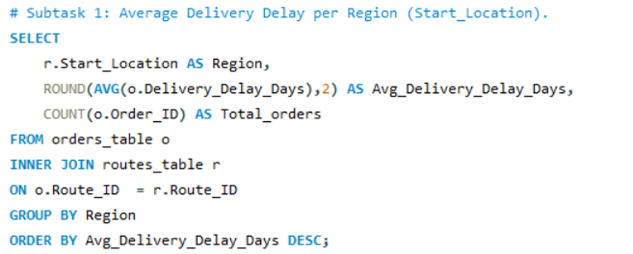
Task 7: Advanced KPI Reporting
Calculate KPIs using SQL queries:
Subtask 1: Average Delivery Delay per Region (Start_Location).
SQL Query :
Insight / How Performed:
Joined orders_table (o) with routes_table (r) using Route_ID.
Grouped by r.Start_Location (treated as Region) and calculated.
Averaged delays across orders originating from each region to produce regional KPIs.

Slide 46
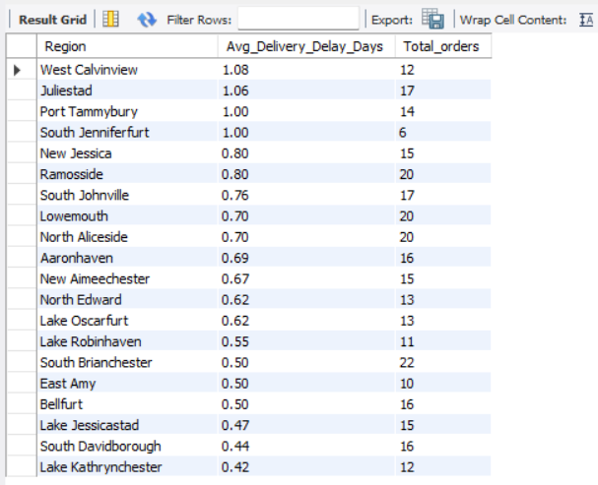
Task 7: Advanced KPI Reporting
Calculate KPIs using SQL queries:
Subtask 1: Average Delivery Delay per Region (Start_Location).
Output :
Result:
Returned 20 rows, each representing a region’s delay performance.
Regions like West Calvinview and Juliestad showed the highest average delays.
Helps form a region-wise heatmap to target logistics improvements.
20 row(s) returned - Regional delivery delay KPIs computed successfully.

Slide 47
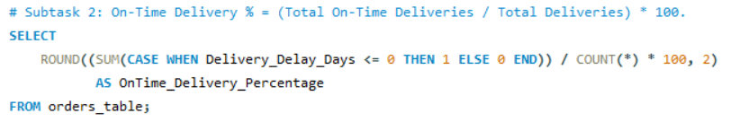
Task 7: Advanced KPI Reporting
Calculate KPIs using SQL queries:
Subtask 2: On-Time Delivery % = (Total On-Time Deliveries / Total Deliveries) * 100.
SQL Query :
Insight / How Performed:
Calculated global on-time delivery rate using : ROUND((SUM(CASE WHEN Delivery_Delay_Days <= 0 THEN 1 ELSE 0 END) / COUNT(*)) * 100, 2).
Counted all deliveries delivered on or before expected date, divided by total deliveries, multiplied by 100.

Slide 48
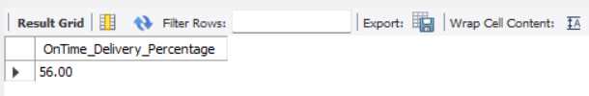
Task 7: Advanced KPI Reporting
Calculate KPIs using SQL queries:
Subtask 2: On-Time Delivery % = (Total On-Time Deliveries / Total Deliveries) * 100.
Output :
Result:
Returned 1 row with global KPI:
OnTime_Delivery_Percentage = 56.00%
Indicates that slightly over half of all deliveries met or beat the scheduled delivery date.
1 row(s) returned - Global on-time delivery percentage calculated.

Slide 49

Task 7: Advanced KPI Reporting
Calculate KPIs using SQL queries:
Subtask 3: Average Traffic Delay per Route.
SQL Query :
Insight / How Performed:
Aggregated ROUND(AVG(Traffic_Delay_Min), 2) per Route_ID, Start_Location, End_Location from routes_table.
Sorted by descending delay to highlight most traffic-affected routes.

Slide 50

Task 7: Advanced KPI Reporting
Calculate KPIs using SQL queries:
Subtask 3: Average Traffic Delay per Route.
Output :
Result:
Returned 20 rows, ranking all routes by their average traffic delay.
Routes R014, R007, and R009 showed the highest delays, signaling potential congestion bottlenecks.
KPI guides re-routing or scheduling optimization strategies.
20 row(s) returned - Route traffic delay KPIs generated successfully.

Slide 51
Recommendations & Future Improvements
Delivery Delay Analysis
Route Optimization Insights
Warehouse Performance
Delivery Agent Performance
Recommendation 1:
Implement Real-Time Delay Alerts: Trigger notifications for any delivery exceeding 2 days delay to allow proactive action.
Recommendation 2:
Optimize Delivery ETA Communication: Adjust expected delivery times on frequently delayed routes to improve customer trust and accuracy.
Recommendation 1:
Re-route High-Delay Routes: Redesign or test alternate paths for R004, R019, and R014 to reduce inefficiencies.
Recommendation 2:
Adopt Dynamic Routing: Integrate live traffic data APIs like Google Maps and Apple Maps or Mapbox for real-time rerouting during congestion.
Recommendation 1:
Automate Warehouse Workflows: Implement automated scanning and order batching in bottleneck warehouses (W010, W009).
Recommendation 2:
Introduce Performance KPIs: Create on-time delivery performance dashboards and incentive programs for warehouse teams.
Recommendation 1:
Coach Underperforming Agents: Provide performance feedback or reassign low on-time agents (<80%) to less congested routes.
Recommendation 2:
Focus on Process Discipline: Since speed isn’t the key differentiator, emphasize timely check-ins and route adherence training.

Slide 52
Recommendations & Future Improvements
Shipment Tracking Analytics
Advanced KPI Reporting
Recommendation 1:
Fix Sorting Delays: Automate sorting and increase staffing during high-volume hours to address 272 “Sorting Delay” cases.
Recommendation 2:
Monitor Multi-Delay Orders: Deploy anomaly tracking for shipments with >2 delayed checkpoints to enable preemptive intervention.
Recommendation 1:
Audit Delay-Prone Regions: Prioritize improvement projects in West Calvinview and Juliestad where average delays are highest.
Recommendation 2:
Build Predictive KPI Dashboards: Implement live dashboards forecasting delivery success probability and SLA compliance risk.

Slide 53
Thank you!
PPT Presentation Video

